Slide 1


Hafiz Putra Amanta
December 31, 2023

Slide 2

Outline
Executive Summary
Introduction
Methodology
Results
Conclusion
Appendix

Slide 3
Executive Summary
The analysis was carried out with the aim of predicting the first stage landing of the Space Data cleansing and preprocessing processes are carried out before selecting the classification model to be used. Evaluation of the model is carried out based on the score of the best parameters. The evaluation results show that the best model that can be used is tree_cv with an accuracy score of 0.88888. This predictive model can be used by Space Y to estimate the costs of rocket launches that must be incurred and can influence Space Y's decisions when participating in tenders for space missions.

Slide 4
Introduction
Space flight is a very expensive project. Various companies provide space flight services at varying costs. One company that offers low-cost space flights is Space X. The Falcon 9 owned by Space X is claimed to cost USD 62 million, compared to other companies, which usually cost up to USD 165 million. This cheaper cost can occur because SpaceX can reuse the first stage of its rocket. The ability to predict the success of the Falcon 9's first-stage landing can make it easier for companies to predict costs. In the end, if the costs incurred by Space X can be predicted, then Space Y can take a more precise policy regarding determining the price that will be offered in the project tender.
Seeing the importance of predicting the success of the Falcon 9 landing, a model is needed that can make predictions regarding this matter accurately.

Slide 5

Section 1

Slide 6
Methodology
Executive Summary
Data collection methodology:
Data is collected from the API provided by Space X as well as by webscraping from Wikipedia pages
Perform data wrangling
Data wrangling is carried out by doing Exploratory Data Analysis (EDA) to find patterns in the data and to determine data labels before preparing a predictive model.
Perform exploratory data analysis (EDA) using visualization and SQL
Perform interactive visual analytics using Folium and Plotly Dash
Perform predictive analysis using classification models
The selection of the classification model is carried out by considering the evaluation scores using training data and test data. The model with the highest score will be selected to predict the success of the Falcon 9's first stage landing

Slide 7
Data Collection
Data was obtained from 2 sources, by utilizing the SpaceX API and by webscraping from the Wikipedia page. The data that has been obtained is then adjusted to the appropriate format. Then, Exploratory Data Analysis (EDA) was carried out and labeling regarding the success or failure of the first stage landing of the Falcon 9.
SpaceX API
Data Wrangling
EDA
Labeling
Input Data
Webscraping from Wikipedia

Slide 8
Data Collection – SpaceX API
Data collection begins by requesting and parsing from the SpaceX API using a GET request. Data in json format is then adjusted into a dataframe using the json_normalize method. The data that has been obtained is then sorted into data related to Falcon 9. Missing values are then handled by inserting the average value from that column.
JSON from SpaceX API
DataFrame
Filtered DataFrame (only Falcon 9)
Replace Missing Values
Github URL: https://github.com/hafizpanst/spacex_by_hafiz/blob/master/1/jupyter-labs-spacex-data-collection-api.ipynb

Slide 9
Data Collection - Scraping
Data was obtained by webscraping the Wikipedia page regarding the launch of the Falcon 9 rocket. The content of the page was obtained using the requests and BeautifulSoup libraries. From this page, look for the table contents. The information from the table is then adjusted to obtain a dataframe regarding the launch of the Falcon 9. The data that has become a dataframe is then adjusted to the format so that a dataframe is obtained in accordance with the expected format.
Wikipedia Page
Get the Page Content using Requests and BeautifulSoup
Find <table>
Parse to DataFrame
Github URL: https://github.com/hafizpanst/spacex_by_hafiz/blob/master/1/jupyter-labs-webscraping.ipynb

Slide 10
Data Wrangling
Data wrangling is carried out by carrying out Exploratory Data Analysis (EDA) such as calculating the number of launches from each Launch Site, calculating the number of launches in each orbit, and calculating the results from the launches of each orbit. Apart from carrying out EDA, data wrangling also includes labeling the success of the Falcon 9 launch based on data in the Outcome column.
Exploratory Data Analysis (EDA)
Labeling
Input Data
Github URL: https://github.com/hafizpanst/spacex_by_hafiz/blob/master/1/labs-jupyter-spacex-Data%20wrangling.ipynb

Slide 11
EDA with Data Visualization
EDA with Data Visualization is carried out by creating several charts that depict the following information:
Relationship between Flight Number and Launch Site
Relationship between Payload and Launch Site
Average success rate for each orbit
The relationship between Flight Number and Orbit
Relationship between Payload and Orbit
Trend of successful launches every year
Github URL: https://github.com/hafizpanst/spacex_by_hafiz/blob/master/2/jupyter-labs-eda-dataviz.ipynb

Slide 12
EDA with SQL
EDA with SQL is carried out to obtain the following information:
List of Launch Site names used in space missions
List of 5 launch data with Launch Site names starting with "CCA“
Total Payload carried by Boosters launched by NASA (CRS)
Average amount of Payload carried by Booster Version F9 v1.1
First successful launch date
The list of names of Boosters who successfully landed with a Payload of more than 4000kg is less than 6000kg
Total successful and failed launch missions
Name of the Booster with the heaviest Payload
Data regarding the moon, Booster Version, and Launch Site that failed to land on the Drone Ship throughout 2015
Recap of landing results (success or failure) sorted in descending order
Github URL: https://github.com/hafizpanst/spacex_by_hafiz/blob/master/2/jupyter-labs-eda-sql-coursera_sqllite.ipynb

Slide 13
Build an Interactive Map with Folium
The Interactive Map is made with several location markers, such as circles and markers to mark each Launch Site. Apart from that, the interactive map also provides Cluster Markers to mark successful launches (Green) and failed launches (Red). The next thing is that distance markers are needed between the Launch Site and several nearby objects such as beaches, railways, highways and cities. It is very important to add these objects to the interactive map to see the pattern of selecting the Falcon 9 Launch Site location as well as consideration of access from nearby transportation. Then provide green and red markers to facilitate analysis of the success of the Falcon 9 launch from each Launch Site by paying attention to the geographical aspects of the Launch Site.
Github URL: https://github.com/hafizpanst/spacex_by_hafiz/blob/master/3/lab_jupyter_launch_site_location.ipynb

Slide 14
Build a Dashboard with Plotly Dash
The dashboard was created to display the composition of each Launch Site from all launches carried out by SpaceX. The dashboard display can change according to the input provided by the user. The dropdown menu options can be changed according to the Launch Site data you want to display. If one Launch Site has been selected, the pie chart will display the composition of successful and failed launches from that Launch Site. This will make it easier for dashboard users to understand the success rate of each Launch Site.
Meanwhile, below the pie chart, the dashboard also displays a scatterplot to illustrate information on the relationship between PayloadMass and launch success. The scatterplot can be adjusted by setting the PayloadMass range in the RangeSlider. The data displayed in the scatterplot is data according to the selected LaunchSite and according to the PayloadMass range entered. This dashboard will make it easier for users to understand the relationship between PayloadMass and the success of a rocket launch.
Github URL: https://github.com/hafizpanst/spacex_by_hafiz/blob/master/3/spacex_dash_app.py

Slide 15
Predictive Analysis (Classification)
Predictive Analysis is carried out based on input data that has been prepared from Data Wrangling. The analysis was carried out with the aim of finding a model that was able to predict the success of the first stage landing of the Falcon 9. The model was trained using train_data which amounted to 80% of the total data. Meanwhile, evaluation is carried out with a confusion matrix using test_data. The score from the model is obtained based on the best score using train_data and also based on the results of the confusion matrix. Based on the analysis results, it was found that the best model was tree_cv with a score using train_data of 0.875 and a score using test_data of 0.8888.
Train The Model using train_data
Input Data
Choose The Best Model
Evaluate The Model using test_data
Github URL: https://github.com/hafizpanst/spacex_by_hafiz/blob/master/4/SpaceX_Machine_Learning_Prediction_Part_5.jupyterlite.ipynb

Slide 16
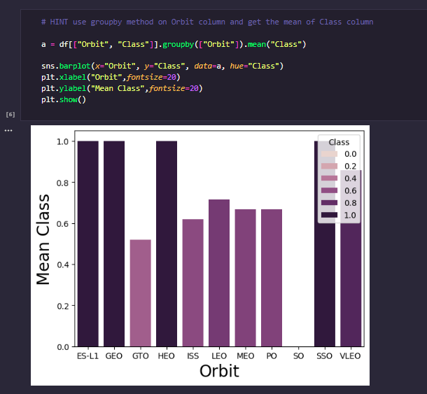
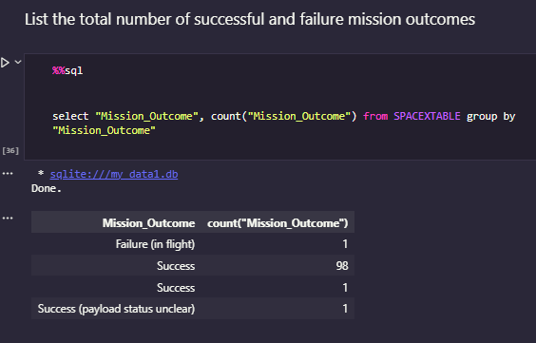
Results
The EDA results can be seen as follows

Slide 17
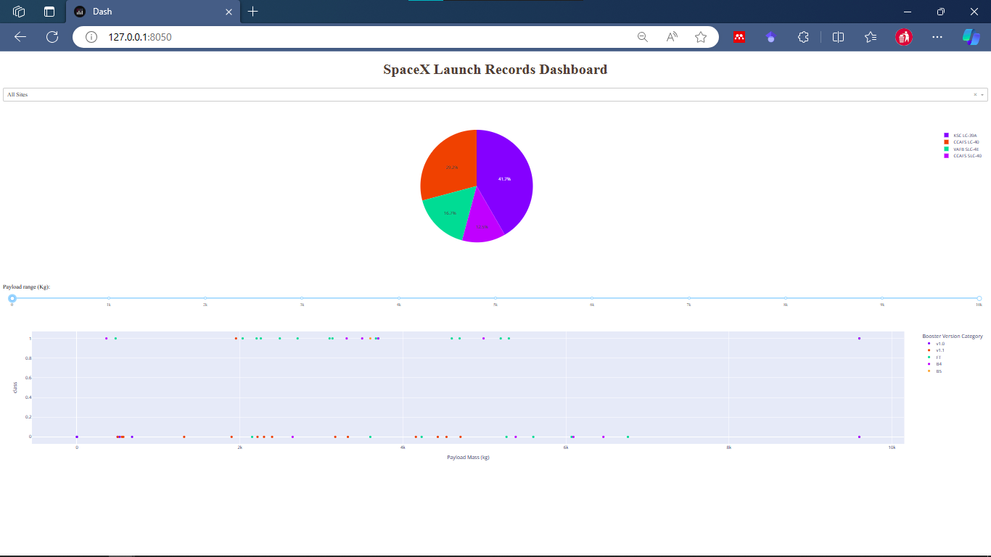
Results
Interactive Analytics using Dashboard

Slide 18
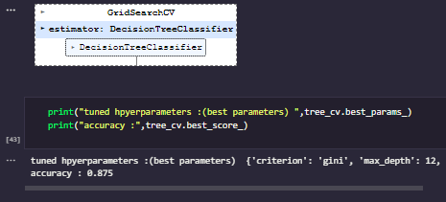
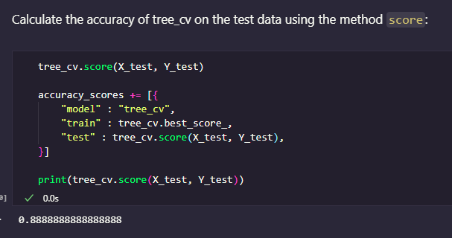
Results
Results from Predictive Analysis

Slide 19

Section 2

Slide 20
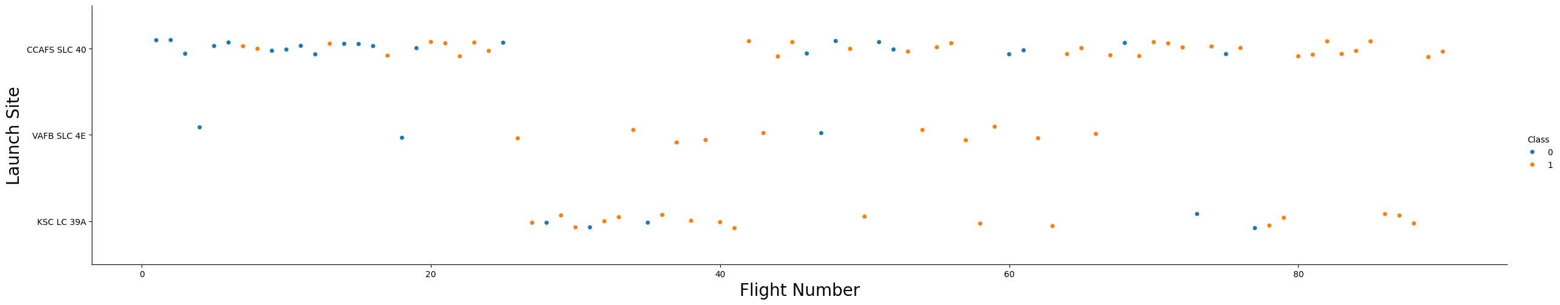
Flight Number vs. Launch Site
Based on the graph above, it can be said that the LaunchSite with the highest number of launches is CCAFS SLC-40. Meanwhile, the LaunchSite with the lowest number of launches is VAFB SLC-4E. At a glance it can be said that of all LaunchSites there are always successful launches and failed launches.

Slide 21
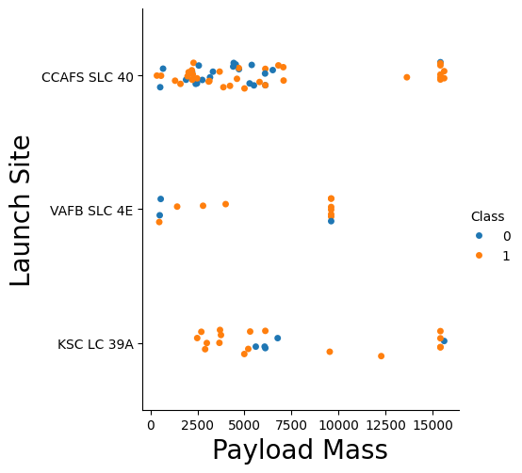
Payload vs. Launch Site
From the graph on the side it can be said that launches with small PayloadMass (<2500kg) only exist on LaunchSite CCAFS SLC 40 and VAFB SLC 4E. Meanwhile launches with large PayloadMass (>12500kg) are only available on the CCAFS SLC 40 and KSC LC 39A LaunchSites. Successful and failed rocket launches are scattered throughout the LaunchSite as well as almost the entire PayloadMass range.

Slide 22
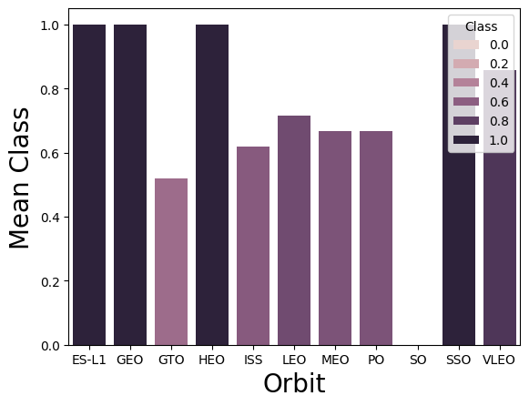
Success Rate vs. Orbit Type
Based on the graph, it can be concluded that the Orbits with the highest SuccessRate are ES-L1, GEO, HEO, and SSO. Meanwhile, the orbit with the lowest SuccessRate is SO

Slide 23
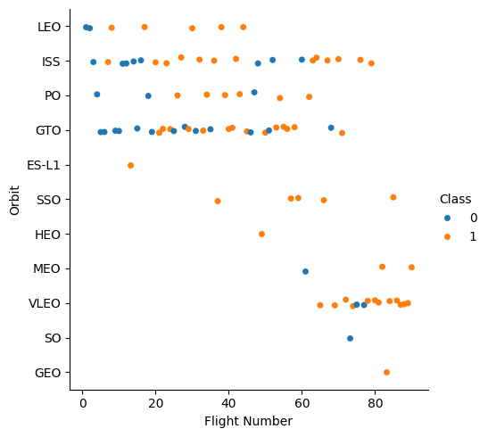
Flight Number vs. Orbit Type
Based on the graph below, it can be concluded that the orbits with the most launches are GTO and ISS. Meanwhile, the orbits with the fewest launches are GEO, SO, HEO, and ES-L1.
When related to launch success, SSO is the most successful orbit with more than 1 launch.

Slide 24
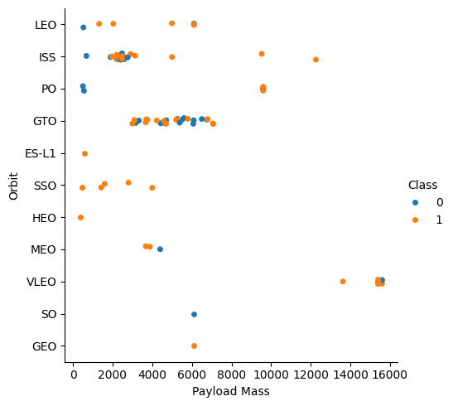
Payload vs. Orbit Type
Based on the graph below, it can be concluded that launches with small PayloadMass (<2000kg) are in the LEI, ISS, PO, ES-L1, SSO and HEO orbits. Meanwhile launches with large PayloadMass (>10,000kg) are on the ISS and VLEO orbits.

Slide 25
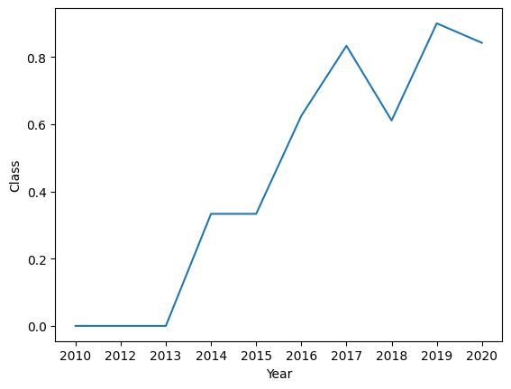
Launch Success Yearly Trend
Based on the graph on the side, it can be concluded that the trend of successful launches tends to increase from year to year, with the exception of 2018 and 2020, where there was a decrease in the success_rate. The year with the highest success_rate was 2019, while the years with the lowest success_rate were 2010, 2012, and 2013.

Slide 26
All Launch Site Names
Launch_Site
CCAFS LC-40
VAFB SLC-4E
KSC LC-39A
CCAFS SLC-40
Based on the query results, a list of Launch Sites is obtained as can be seen on the side.

Slide 27
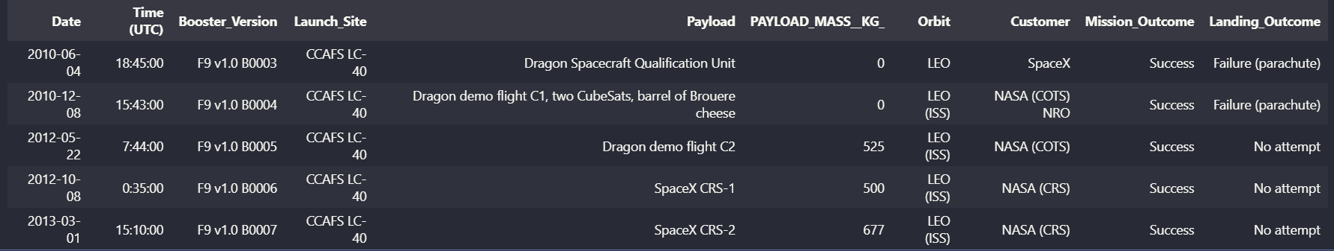
Launch Site Names Begin with 'CCA'
Here are 5 Launch Sites with names starting with "CCA"

Slide 28
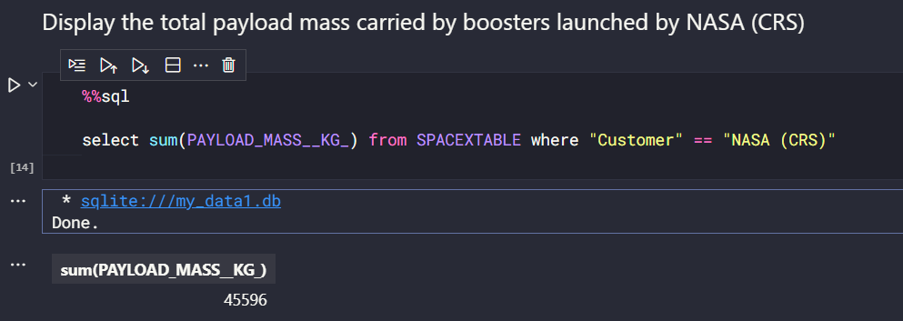
Total Payload Mass
Based on EDA results using SQL, information was obtained regarding the total Payload Mass carried by the Booster launched from NASA (CRS) of 45,596kg.

Slide 29
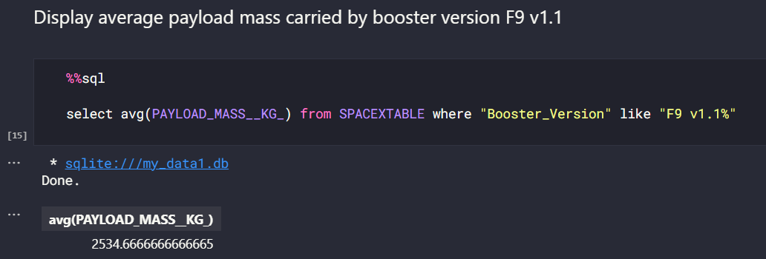
Average Payload Mass by F9 v1.1
Based on EDA results using SQL, information was obtained regarding the total Payload Mass carried by the Booster launched from NASA (CRS) of 45,596kg.

Slide 30
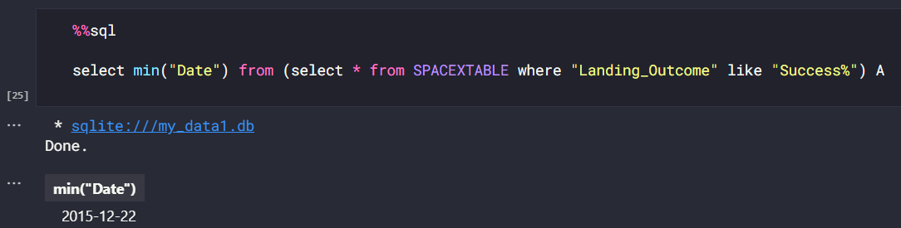
First Successful Ground Landing Date
Based on EDA results using SQL, it is known that the first successful landing mission occurred on December 22, 2015

Slide 31
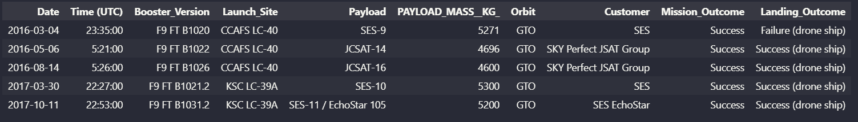
Successful Drone Ship Landing with Payload between 4000 and 6000
Based on EDA results using SQL, a list of successful Drone Ship Landings with Payload Mass greater than 4000kg and smaller than 6000kg was obtained. It was found that there were 5 launches that met these criteria.

Slide 32
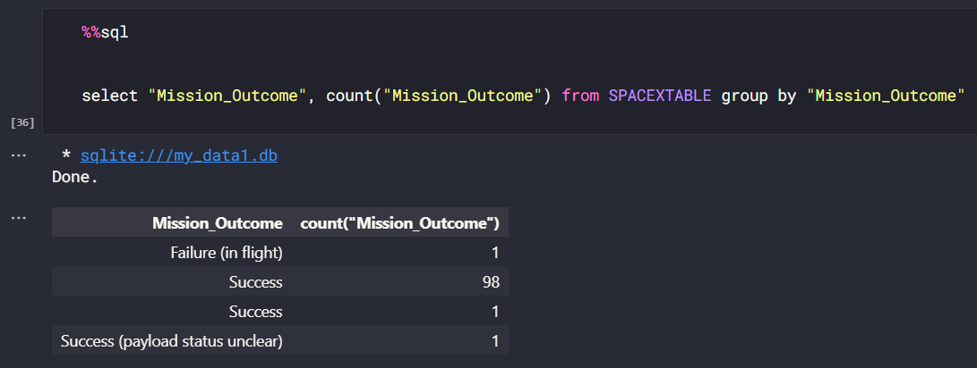
Total Number of Successful and Failure Mission Outcomes
Based on EDA results using SQL, information is obtained regarding the number of each Mission_Outcome. From these results it can be seen that the majority of mission outcomes are success.

Slide 33
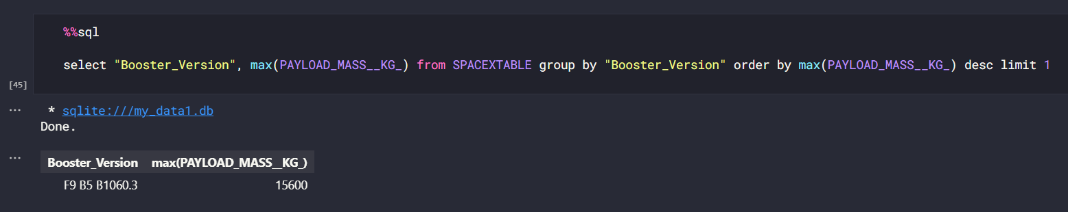
Boosters Carried Maximum Payload
Based on EDA results using SQL, it is known that the Booster Version with the largest number of PayloadMass is F9 B5 B1060.3, with a total of 15,600kg

Slide 34
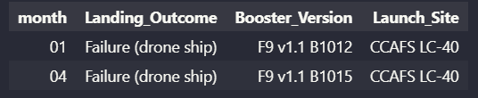
2015 Launch Records
Based on EDA results using SQL, information was obtained regarding the launch in 2015 with the result of a failed landing on a drone ship. From the query results you can find out in what month the launch was carried out, what Booster Version was used, and from which Launch Site.

Slide 35
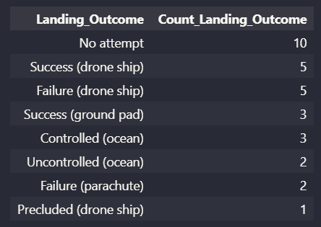
Rank Landing Outcomes Between 2010-06-04 and 2017-03-20
Based on EDA results using SQL, information was obtained regarding landing results from all launches carried out from 2010-06-04 to 2017-03-20.
Based on the analysis results, it is known that the highest result is "No Attempt", while the least result is "Precluded (Drone Ship)".

Slide 36

Section 3

Slide 37
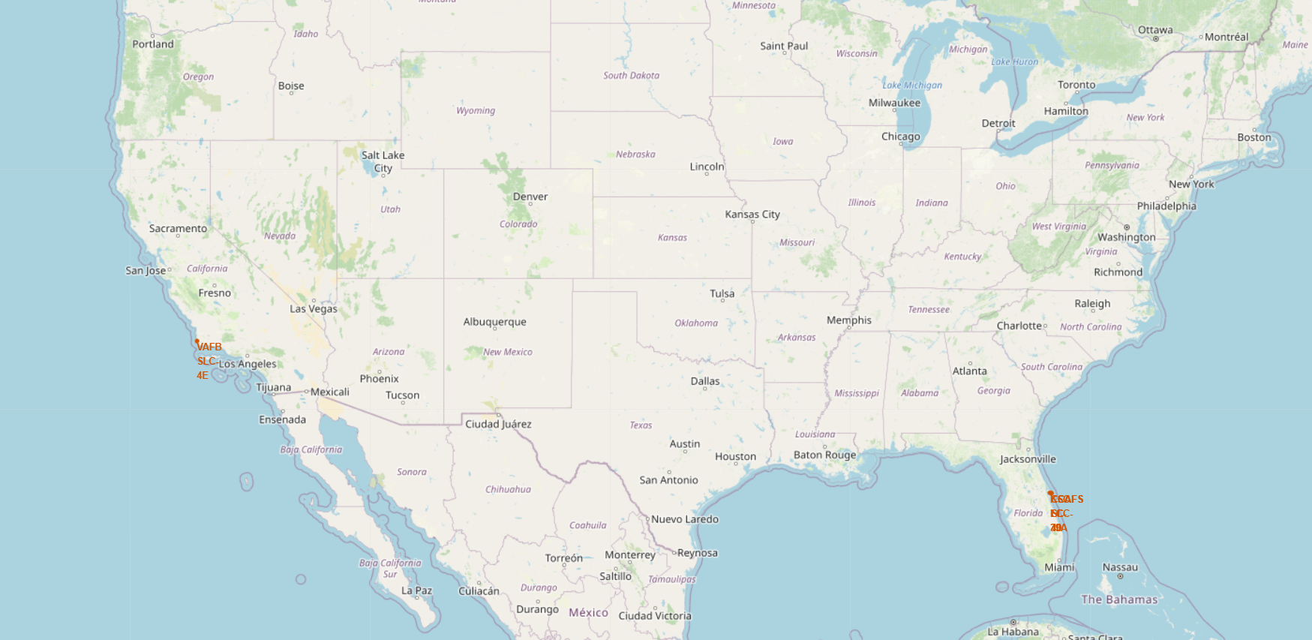
Marking All Launch Sites
Based on the picture on the side, it can be concluded that all Launch Sites are close to the coast, both the east coast and the west coast of the United States.

Slide 38
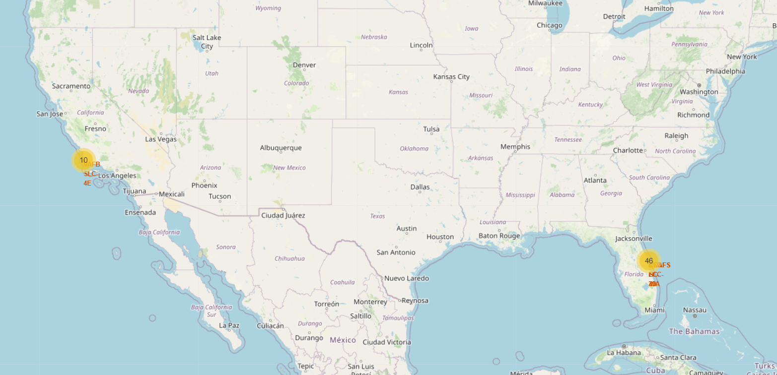
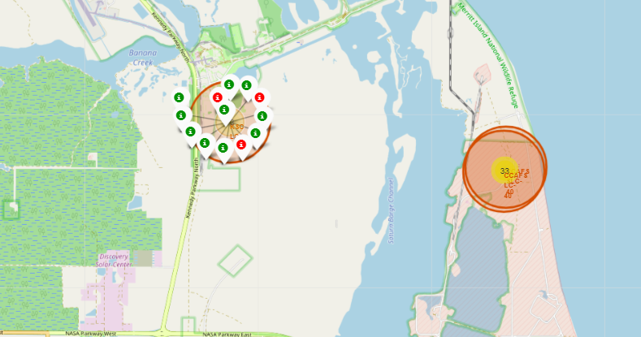
Mark The Success/Failed Launches
Based on the picture on the side, information is obtained regarding the number of launches from the east coast (46) and the west coast (10).
For example, as can be seen on the KSC LC-39A Launch Site on the east coast, there were 13 launches, 10 of which were successful and 3 failed.

Slide 39
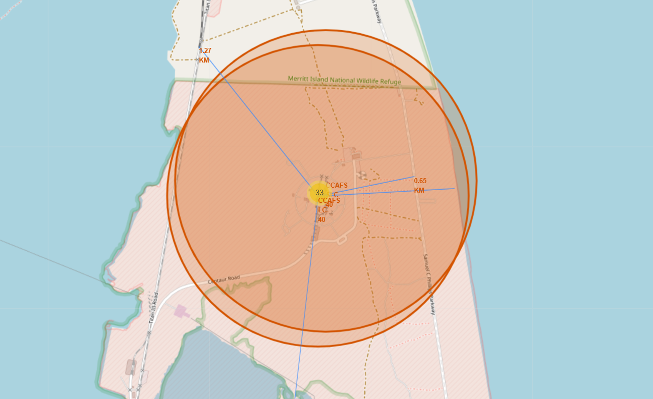
Distance Between Launch Site and Other Objects
Based on the picture on the side, information is obtained regarding the distance from the Launch Site to several nearby highway, railway and city objects.
For example, on the side is the CCAFS LC-40 Launch Site. From the image below, information is obtained that the Launch Site is 0.65km from the Samuel C Phillips Parkway, 1.27km from the nearest railway, and 51.10km from the City of Melbourne.

Slide 40

Section 4

Slide 41
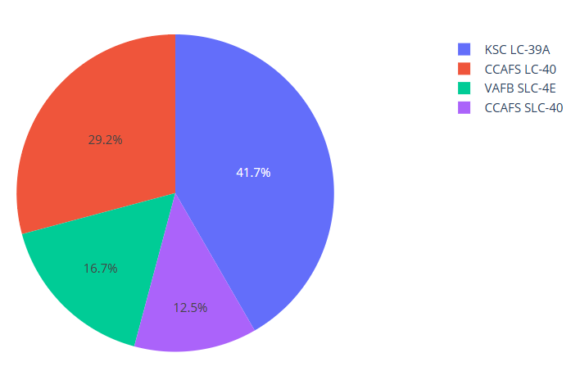
Launch Success Count from Each Launch Sites
Based on the graph on the side, it can be seen that the Launch Site with the most successful launches was KSC LC-39A, while the Launch Site with the fewest successful launches was CCAFS SLC-40.

Slide 42
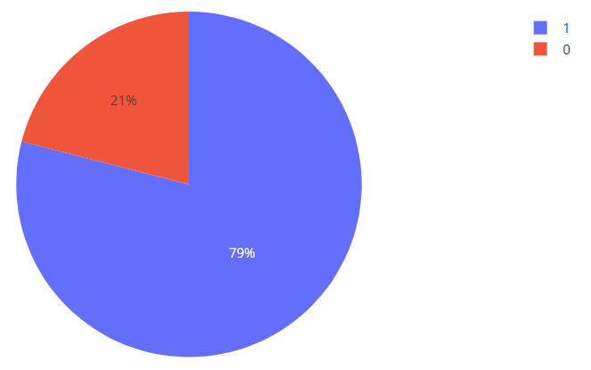
Success/Failed Mission from KSC LC-39A
Based on the graph on the side, it can be concluded that most of the launch results from KSC LC-39A were successful (79%). Meanwhile, the results of failed launches were only 21% of the total launches carried out.

Slide 43
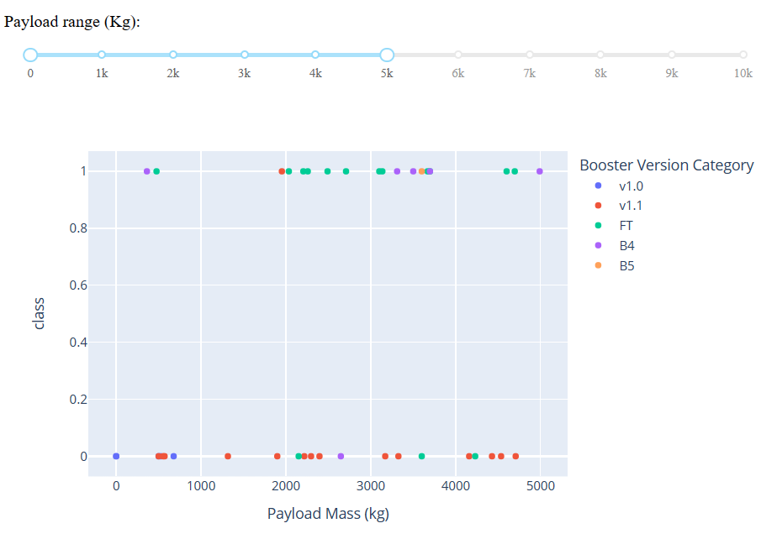
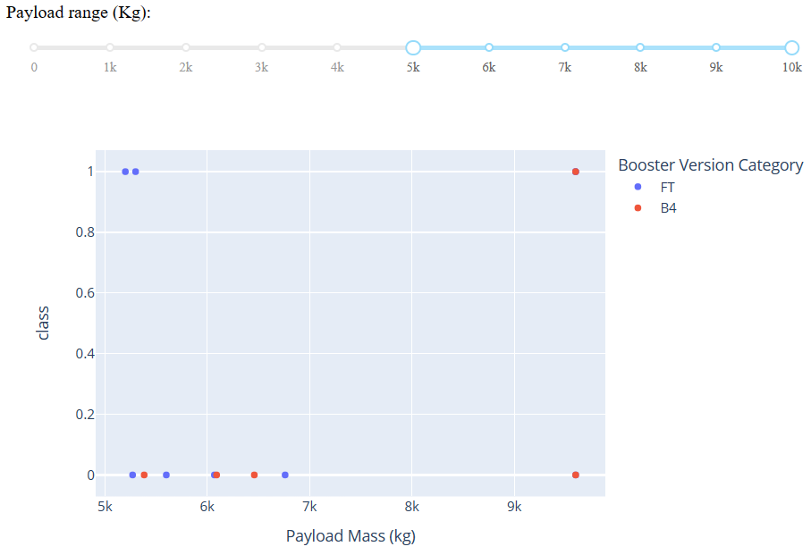
PayloadMass vs Launch Outcome
Based on the graph above, it can be seen that launches with small Payload Mass (<= 5000kg), using various Booster Versions and have results that tend to vary. Meanwhile, launches with large Payload Mass (>= 5000kg) only used Booster Versions FT and B4, and most of the launch results were failed.

Slide 44

Section 5

Slide 45
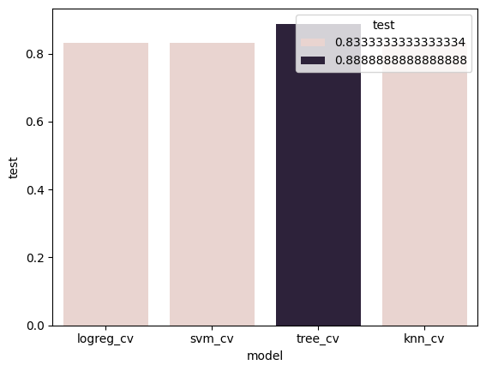
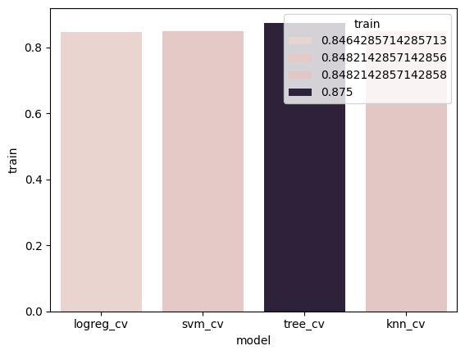
Classification Accuracy
Based on the evaluation results, it is known that the model with the best level of accuracy is tree_cv with an accuracy of 0.88888
When using train_data, the highest accuracy result is still tree_cv with a score of 0.875

Slide 46

Confusion Matrix
From the confusion matrix on the side it can be seen that of the 18 test_data, tree_cv succeeded in correctly classifying 16 data. There is only 1 "landed" data that is predicted to "did not land" and there is only 1 "did not land" data that is predicted to be "landed".

Slide 47
Conclusions
Based on the results of predictive analysis, the tree_cv model was obtained which was able to predict the success of the Falcon 9 landing with an accuracy of 0.888888. This model can be used by Space Y to predict landing success so that it can make decisions on tenders and costs for launching space rockets.

Slide 48
Appendix
All material can be seen at the following Github link: https://github.com/hafizpanst/spacex_by_hafiz

Slide 49


